Slide 1
Strategic Plan Inquiry: Are courses being accepted for college credit?

Slide 2
Strategic Plan: Target Goal
To determine whether the dual credit (ACCP) and AP courses are being accepted for college credit
If not, why?

Slide 3
Strategic Plan: Targeted Action
Surveyed alumni from 2019—2023 who took:
ACCP (duel credit) courses
AP courses (scored 3-5)

Slide 4
Survey Demographics
Total Students | 70
Total Courses | 370

Slide 5
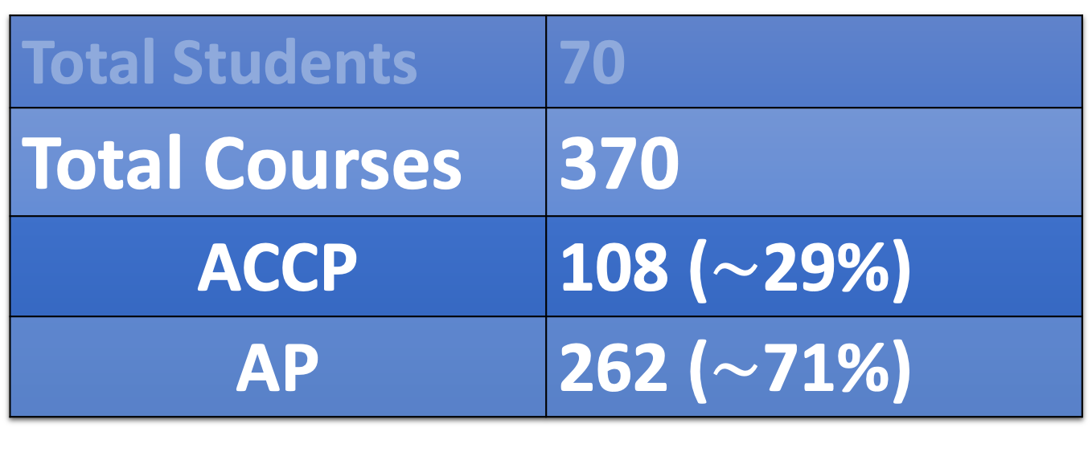
Survey Demographics
Total Students | 70
Total Courses | 370
ACCP | 108 ($\sim$29%)
AP | 262 ($\sim$71%)

Slide 6
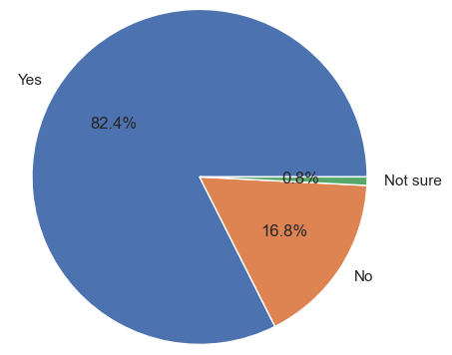
Survey Demographics
Total Acceptance Rate: ACCP & AP

Slide 7
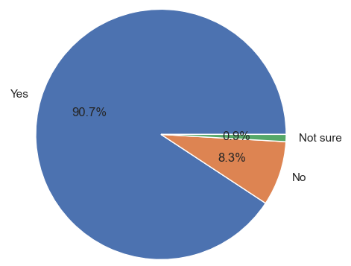
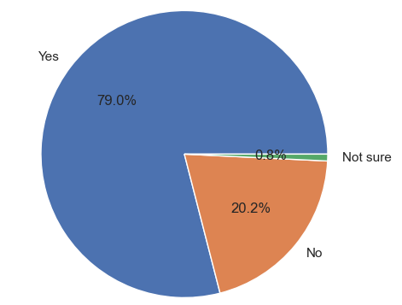
Survey Demographics
Acceptance Rate: ACCP
Acceptance Rate: AP
N = 108
N = 262

Slide 8
Survey Demographics
Acceptance Rate: ACCP
Acceptance Rate: AP
N = 108
N = 262
???

Slide 9
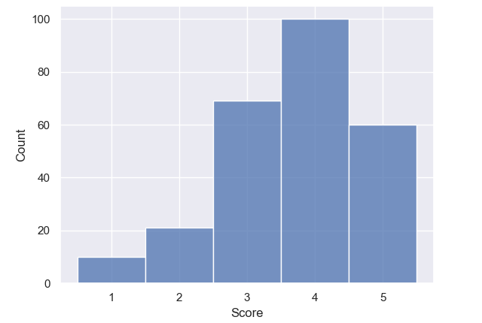
Discoveries
AP Course Scores
N = 262

Slide 10
Discoveries
AP Course Scores
N = 262
Scores < 3

Slide 11
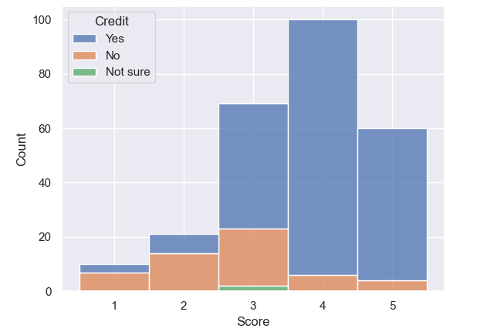
Discoveries
AP Course Scores
N = 262

Slide 12
Discoveries
AP Course Scores
N = 262
Largely NOT accepted

Slide 13
Discoveries
AP Course Scores
N = 262
Suspicious:
Unlikely to have scores < 3 accepted

Slide 14
Discoveries
AP Course Scores
N = 262
Largely accepted

Slide 15
Discoveries
AP Course Scores
N = 262
Suspicious:
Unlikely to have scores > 3 rejected

Slide 16
Discoveries
AP Course Scores
N = 262
Mixed outcomes

Slide 17
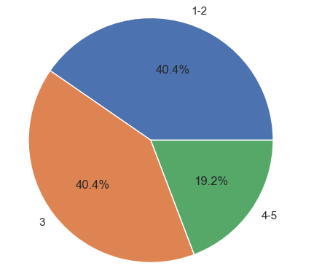
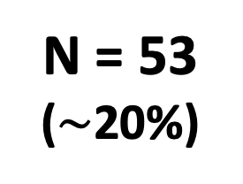
AP Scores: NOT accepted
N = 53
($\sim$20%)
Insights
Notes:
AP scores, no credit

Slide 18

AP Scores: NOT accepted
$\sim$80%
N = 53
($\sim$20%)
Insights
Notes:
AP scores, no credit

Slide 19
AP Scores: NOT accepted
$\sim$80%
N = 53
($\sim$20%)
Insights
???
Notes:
AP scores, no credit

Slide 20
Explanations
AP Course Scores
N = 262

Slide 21
Explanations
AP Course Scores
N = 262
Discrepancy in acceptance among colleges:
Scores 3-5
Or
Scores 4-5

Slide 22
Explanations
AP Course Scores
N = 262

Slide 23
Explanations
AP Course Scores
N = 262
Colleges often do NOT accept “English Lit”& “English Lang” together

Slide 24
Explanations
AP Course Scores
N = 262
Colleges often do NOT accept “English Lit”& “English Lang” together

Slide 25
Discoveries
AP Course Scores
N = 262
Erroneous

Slide 26
Take Home Points
Roughly 80% of AP courses are being accepted for college credit
Scores < 3 were present in the survey
Most AP scores of 4-5 are accepted
Most AP scores of 1-2 are NOT accepted
AP scores of 3 show variable outcomes depending on college of choice

Slide 27
Take Home Points
Roughly 80% of AP courses are being accepted for college credit
Scores < 3 were present in the survey
Most AP scores of 4-5 are accepted
Most AP scores of 1-2 are NOT accepted
AP scores of 3 show variable outcomes depending on college of choice

Slide 28
Take Home Points
Roughly 80% of AP courses are being accepted for college credit
Scores < 3 were present in the survey
Most AP scores of 4-5 are accepted
Most AP scores of 1-2 are NOT accepted
AP scores of 3 show variable outcomes depending on college of choice

Slide 29
Take Home Points
Roughly 80% of AP courses are being accepted for college credit
Scores < 3 were present in the survey
Most AP scores of 4-5 are accepted
Most AP scores of 1-2 are NOT accepted
AP scores of 3 show variable outcomes depending on college of choice

Slide 30
Take Home Points
Roughly 80% of AP courses are being accepted for college credit
Scores < 3 were present in the survey
Most AP scores of 4-5 are accepted
Most AP scores of 1-2 are NOT accepted
AP scores of 3 show variable outcomes depending on college of choice

Slide 31
Next Steps
Revamp survey to include drop-down menus to standardize some of the answers (e.g., class names and reasons for not being accepted)
Is the acceptance of AP scores (particularly for 3 scores) dependent on student’s major?
Are both AP “English Lit” and “English Lang” needed?
Bring awareness to the college-dependent acceptance of AP scores of 3

Slide 32
Next Steps
Revamp survey to include drop-down menus to standardize some of the answers (e.g., class names and reasons for not being accepted)
Is the acceptance of AP scores (particularly for 3 scores) dependent on student’s major?
Are both AP “English Lit” and “English Lang” needed?
Bring awareness to the college-dependent acceptance of AP scores of 3

Slide 33
Next Steps
Revamp survey to include drop-down menus to standardize some of the answers (e.g., class names and reasons for not being accepted)
Is the acceptance of AP scores (particularly for 3 scores) dependent on student’s major?
Are both AP “English Lit” and “English Lang” needed?
Bring awareness to the college-dependent acceptance of AP scores of 3

Slide 34
Next Steps
Revamp survey to include drop-down menus to standardize some of the answers (e.g., class names and reasons for not being accepted)
Is the acceptance of AP scores (particularly for 3 scores) dependent on student’s major?
Are both AP “English Lit” and “English Lang” needed?
Bring awareness to the college-dependent acceptance of AP scores of 3

